Slide 1
Data Structures and Algorithms IICT-6005
Lesson 13 – Bucket Sort

Slide 2
Lesson Content
Comparison sort speeds
Bucket sort as an alternative to comparison sorts
Bucketing
Bucket sort
Analysis of Bucket sort

Slide 3
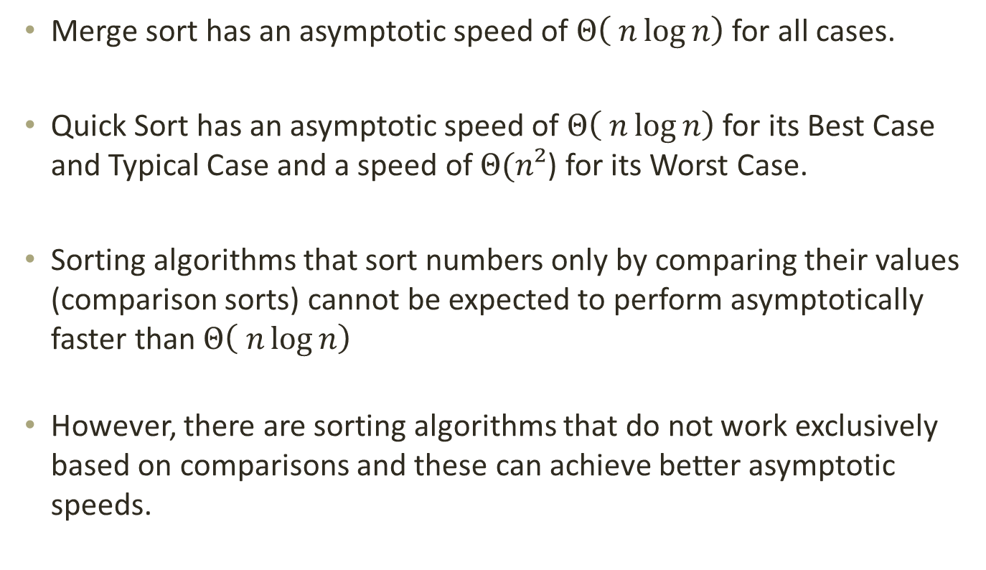
Comparison Sort Speeds
Merge sort has an asymptotic speed of $Θ\left( n\log{n}\right)$ for all cases.
Quick Sort has an asymptotic speed of $Θ\left( n\log{n}\right)$ for its Best Case and Typical Case and a speed of $Θ(n²$) for its Worst Case.
Sorting algorithms that sort numbers only by comparing their values (comparison sorts) cannot be expected to perform asymptotically faster than $Θ\left( n\log{n}\right)$
However, there are sorting algorithms that do not work exclusively based on comparisons and these can achieve better asymptotic speeds.

Slide 4
Bucket Sort
Bucket Sort is one of these algorithms. Due to the way it works, it is not constrained by the speed bound for comparison sorts.
Bucket sort uses “bucketing” to split the data into separate subsets called “buckets”.
The algorithm is designed around assumptions on the input which can help it achieve speeds which are as fast as O(n).

Slide 5
Bucketing
Assume that a sequence of elements which needs to be sorted has a minimum and a maximum value.
Numbers in the sequence are fairly well distributed between these minimum and maximum values.
Bucketing will create “Buckets” for these values and place each element into the bucket that corresponds to its value.
Each bucket will be associated with only 1 (or a small range) of values.
Therefore, it is expected that each bucket will only contain a small number of elements.

Slide 6
Bucketing
5
1
4
2
2
0

Slide 7
Bucketing
5
1
4
2
2
0
0
1
2
3
4
5

Slide 8
Bucketing
5
1
4
2
2
0
5
0
1
2
3
4
5

Slide 9
Bucketing
1
4
2
2
0
2
0
1
2
4
5
0
1
2
3
4
5

Slide 10
Bucketing
We then empty the Buckets in order to achieve a sorted sequence
2
0
1
2
4
5
0
1
2
3
4
5
0
1
2
2
4
5

Slide 11
Bucket sort
Bucket sort uses bucketing to divide the sorting problem into several smaller sorting problems.
Create n buckets where n is the Max Value in the sequence + 1. This creates an array with indexes from 0 to MaxValue
Use each index in the array as a bucket to place all the elements in the input problem inside the corresponding bucket.
Join the sorted array from each bucket, one after the other to finalise the output.

Slide 12
Bucket sort
To minimize on space, we can have buckets that store a range of elements rather than just 1 kind of element
5
1
4
2
2
0
1
2
5
0
2
4
0 - 1
2 - 3
4 - 5

Slide 13
Bucket sort
In this case, each Bucket needs to be sorted individually before being empties
1
2
5
0
2
4
0
2
4
1
2
5

Slide 14
Bucket sort
0
2
4
1
2
5
0 - 1
2 - 3
4 - 5
0
1
2
2
4
5

Slide 15
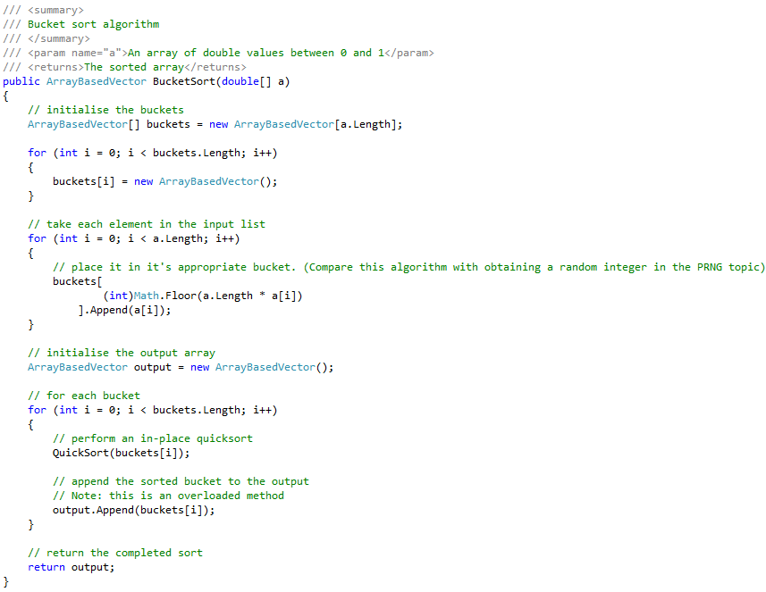
Bucket sort

Slide 16
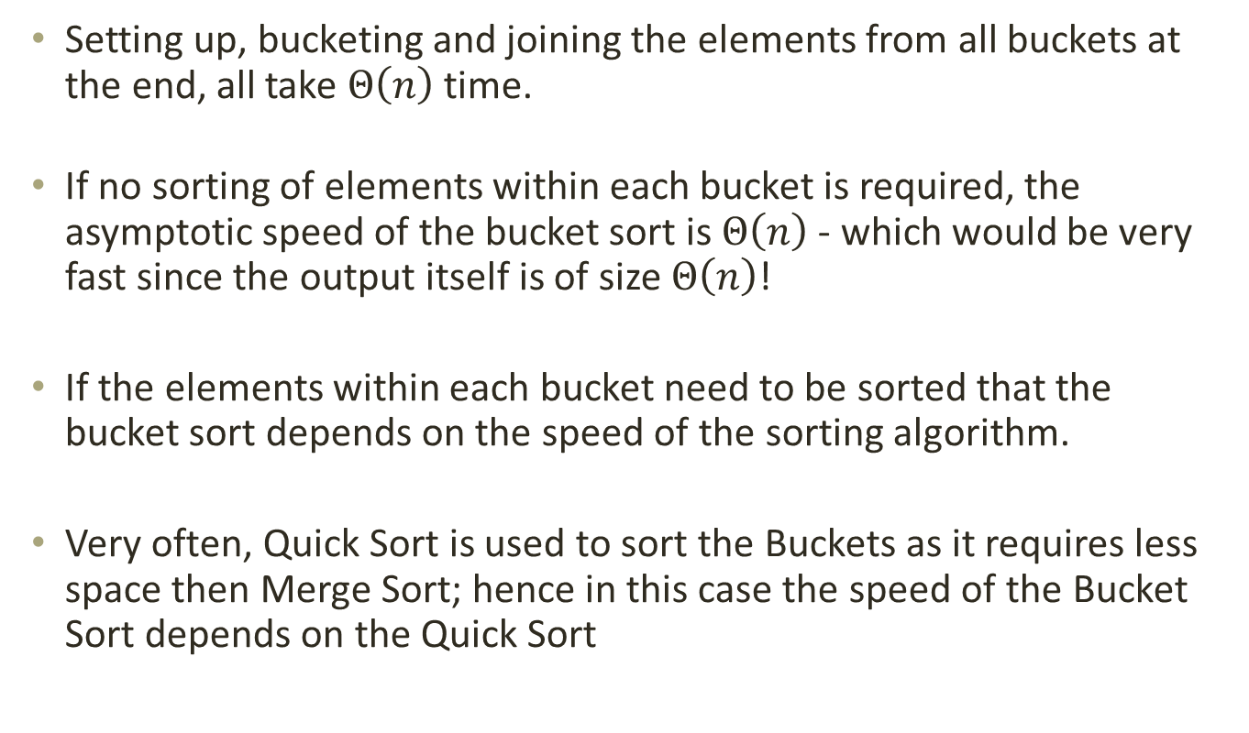
Analysis of Bucket sort
Setting up, bucketing and joining the elements from all buckets at the end, all take $Θ\left(n\right)$ time.
If no sorting of elements within each bucket is required, the asymptotic speed of the bucket sort is $Θ\left(n\right)$ - which would be very fast since the output itself is of size $Θ\left(n\right)$!
If the elements within each bucket need to be sorted that the bucket sort depends on the speed of the sorting algorithm.
Very often, Quick Sort is used to sort the Buckets as it requires less space then Merge Sort; hence in this case the speed of the Bucket Sort depends on the Quick Sort

Slide 17
Summary
Comparison sort speeds
Bucket sort as an alternative to comparison sorts
Bucketing
Bucket sort
Analysis of Bucket sort

Slide 18
End of lesson
Any questions?

